Slide 1


SESE TOUR 2022
Systems Engineering
for a Sustainable World
Sustainable Mediator: Increase the quality of driving on the road in the new vehicles of level 2,3,4
Tiziana Santhià
10 May 2022

Slide 2
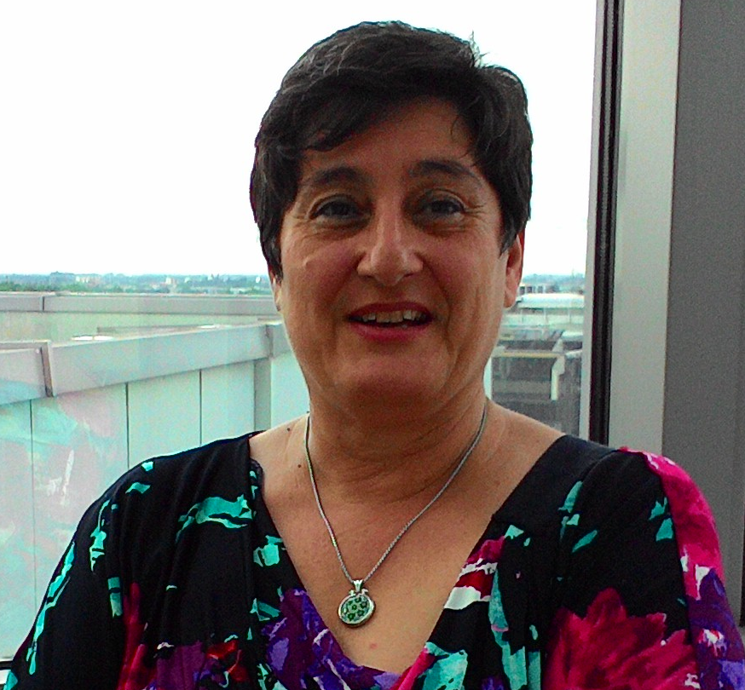
Biography
Tiziana Santhià
  Several years of experience in automotive ADAS, EE system & product;
  I worked for Car Maker and Engineering Companies (Stellantis, Maserati, Ferrari, Volkswagen/Audi, Ital Design, Pirelli).
  I worked on ADAS functionalities on the EU projects (CRF support), as system engineer in the product life cycle management for Active and Passive Safety domain.
  Since 2018 as ADAS Expert, as technical leader, for EU MEDIATOR and internal projects in MBSE.

Slide 3
Agenda
Project Overview
State of Art
Impact (in the sustainable world)

Slide 4
MEDIATING BETWEEN DRIVER AND INTELLIGENT AUTOMATED TRANSPORT SYSTEMS ON OUR ROADS
The H2020 project MEDIATOR will develop a mediating system for drivers in semi-automated and highly automated vehicles, resulting in safe, real-time switching between the human driver and automated system based on who is fittest to drive.
MEDIATOR will be, intelligently, evaluated the strengths and weaknesses of both the driver and the automation and mediate between them, while also monitoring the driving context.
Notes:
MEDIATOR is a 4-year project led by SWOV. It started in May 2019. MEDIATOR will develop a Mediating system for drivers in semi-automated and highly automated vehicles, resulting
in safe, real-time switching between the human driver and automated system based on who is most fit to drive.
In all transport modes (road/rail vehicles, marine vessels and aircraft), new technological developments and automation fundamentally change the role of humans when interacting with machines and the environment
In particular, these developments have substantial potential to improve safety, since they reduce the influence of human fallibility.
The transition to full automation, however, brings new risks, such as mode confusion, overreliance, reduced situational awareness and misuse.
The driving task changes to a more supervisory role, reducing the task load and potentially leading to degraded human performance. Similarly, the automated system may not (yet) function in all situations.
it is crucial to ensure an unambiguous, smooth and safe co-operation between the human and the system, switching between the two and integrating the best of both.
ME system aims to solve some of the well-known driver-vehicle interaction problems occurring at intermediate automation levels (SAE levels 2–4), such as impaired driver states (e.g., fatigue or inattention), overreliance and/or poor take-over performance.

Slide 5
MEDIATOR Video starts in automatic
https://www.youtube.com/watch?v=Hp3l9GlqeQ0&feature=youtu.be
Notes:
Short video explains better the objectives of this EU project 180 MG not inserted

Slide 6













Consortium
MEDIATOR
End Manufactures
Tier Supplier
Knowledge Center
Research Structures
Duration - 4 years
May 2019- April 2023
Team
12 partners, 6 countries
Budget
€ 6,5 M EC contribution
€ 10M in total
Notes:
The MEDIATOR project is carried out by a consortium with a mix of research organizations (knowledge institutes and universities) and industry (technology developers, OEMs and suppliers).
The majority of the partners have a substantial experience in European-funded projects and represent multi-disciplinary knowledge, expertise and skills that are needed for the realization of the Mediator system. The corect balance of the:
HMI design skills, vehicle automation knowledge, the ability to ‘translate’ the human factor knowledge into concrete decision algorithms,
to develop and implement the necessary soft- and hardware, and last but not least, the methodological and statistical knowledge to carry
out scientifically valid evaluation studies and quantify the safety impact.

Slide 7
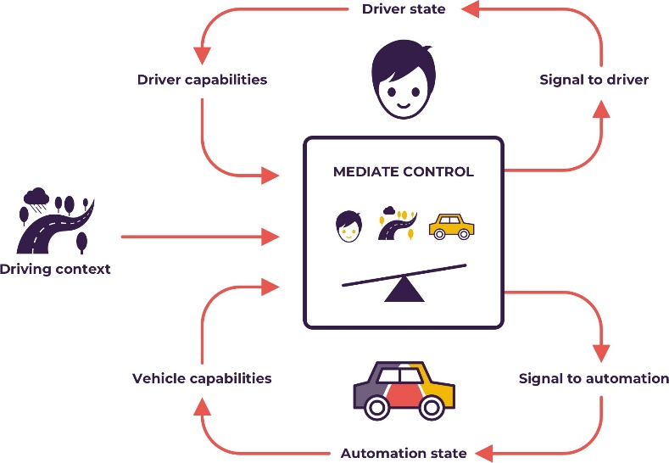
Goals
Develop an adaptive support system, based on in-depth knowledge, on human factors, to mediate between human driving and automated driving system in the vehicles with automation levels 2, 3, 4 (SAE J3016).
The mediator continuously monitors and weighs driving context, driver competences and vehicle capabilities in order to mediate control between driver and vehicle.
Notes:
The ME system to achieve this goal, a broad range of sensors and systems will be developed, implemented, and integrated throughout the project to continuously capture relevant information from outside (e.g., traffic situation), and inside the vehicle (e.g., driver state) to decide who should be in control or how to improve the driver state.
CM Continuous Mediation (automation level)
KPI Key Performance Indicator KSS Karolinska Sleepiness Scale NDRT Non-Driving Related Task
SB Driver Standby (automation level)
TTAF Time To Automation Fitness TTAU Time To Automation Unfitness TTDF Time To Driver Fitness TTDU Time To Driver Unfitness
TTDC Time To Driver Comfort TTDD Time To Driver Discomfort
TtS Time To Sleep (automation level) UC Use Case

Slide 8
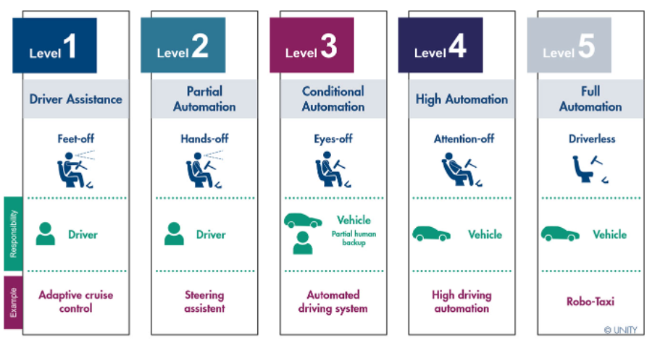
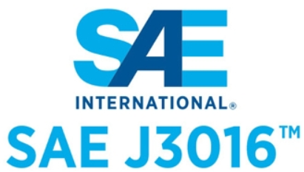
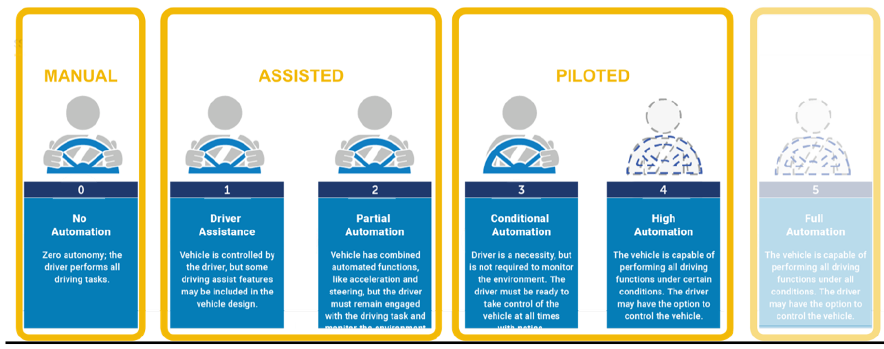

Levels of Automation
Continuous Meditation
Driver standby
Time to Sleep
Notes:
For road transport, the transition to full automated driving (L5) will be effectuated in progressive steps3: driver assistance (SAE Level 1), partial automation (SAE Level 2), conditional automation (SAE Level 3), high automation (SAE Level 4)
It is important to note that automation levels 2, 3 and 4 require shared control by human drivers and automation
To improve the safety MEDIATOR focuses on mitigating human factors issues generic for all transport modes, with road transport as the main use case.
At these levels, the task of the driver is changing from active involvement to more passive supervising, and this is a major challenge In MEDIATOR are :
3 identified driving modes (adapted SAE levels) in order to narrow down the amount of mode switches during the WP1 :
Manual driving (SAE level 0-1) refers to driving without automation (ADAS appl) in which the driver is in full control.
In Assisted driving or Continuous Meditation, (L2-3) the driver maintains some responsibilities and therefore is not fully out of the loop, with proper feedback the driver could have a monitoring task( with ADAS functionalities are ON.
CM= sharing control between driver and automation. While the automation is performing active control of the vehicle.
In Piloted driving mode (Stand By and TtS time to sleep L4) the vehicle performs most or almost all driving tasks.
Driver standby (SB) centres around the main challenges in conditional automation, where automation can take over full control and the driver can be “out of the loop” for periods of
time.
Time to Sleep (TtS) focuses on challenges within high automation, where the driver can abstain from the driver task for long periods of time.

Slide 9
System Architecture
Driver Status
Monitoring
HMI
Management
Decision Logic
Module
Automation Driving
Module
HMI
Actuation
The system will be tested in two simulator , one SIL bench and two prototype vehicles ready and validated on-road use cases defined during the definition work packages.
Notes:
The mediator system continuously monitors and weighs driving context, driver competences and vehicle capabilities in order to mediate control between driver and vehicle.
DS system: via different sensors monitoring drivers' behaviour and physiological activity (estimates the time to driver (un)fitness and time to driver (dis)comfort used to decide who is fittest to drive)
DL Relevant information for factors affecting automation fitness will be collected, like for example, type of the road, road state (e.g., road marking quality), road layout (e.g., curviness), traffic status (e.g., dense traffic, vulnerable road users), weather and light conditions, and potential obtrusive objects in the path.
AS manages information on current automation state based on input data about the driving context
GTW/DL: where the information from the automation state, driving context, and the driver state is integrated and subjected to a decision logic process to determine the best action.
HMI communicates with the driver in based of the input from DL ME module in order to facilitate the negotiations between driver and automation, guides control transfers between driver and automation (takeovers), informs which systems are switched on or switched off, executes actions to increase or maintain driver fitness, and takes
account of driver preferences.
Different existing HMI guidelines and the lessons learnt from aviation, and maritime sectors will be considered in the development of this MEDIATOR component
Main Concept:
Correptive and preventive mediation in term of improve a fluent transition between intermediate level of automation (L2-L4)
Time budgets of trip, time automation, time to driving in level, refers to the principle to show to the driver, clearly and at all times, how long the current level of automation will last.

Slide 10
State of Art
Use Case Definition
Identification of the critical use case for the scenarios of the mediation between Automation and Human system
Functional Requirement Definition
Definition of the functional requirements for each UC in order to cover the transition from:
HMI Concept
Design
Design Logical architecture of the ME main logical modules (DS, DL, AS and HMI)
EE Architecture Definition
Identification of the 5 platforms (2 simulators, 1SIL, 2 proto vehicles) to test part of the ME modules
System Design
Identification of the logical modules
Needs and goals for each modules
SAE Level 2:
(Continuous Mediation)
level 3:
(Driver Stand by)
level 4:
(Time to Sleep)
Classification of the best HMI components
Definition of the behaviour for each HMI
HMI components sourcing, benching and purchasing in the commercial market for the ME system
Stellantis proto vehicle
Dedinition the EE architecture and adjustment the logical modules in the
May 2019
December 2019
October 2020
May 2021
T1.5
T2.5
T2.8

Slide 11
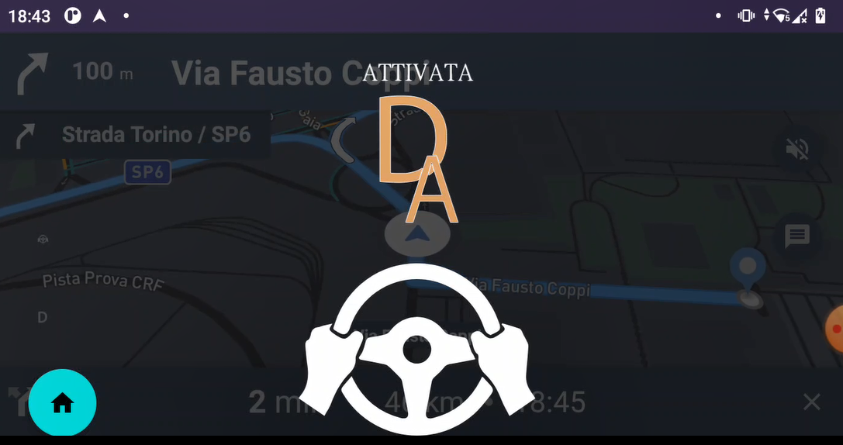
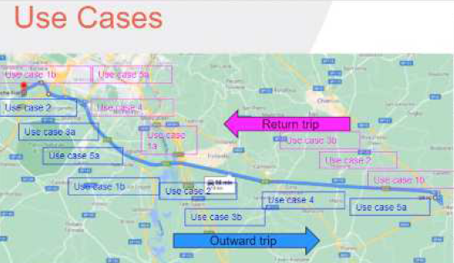
State of Art
«Renegade» vehicle proto
Installation & integration of the HMI components and ME system
Development of ME LAN Ethernet communication between SW main components
HMI components Test & Integration
Test in Laboratory of each components
HMI Module Implememtation
Development the LAN communication protocol for all ME modules
Safety Analysis for the integrated components (seat belt, 2° Steering wheel, Frontal display)
Analisys of the power consumption energy balance
Development of the HMI function routine for each UC
implement a automatic procedure to reproduce the test sequences automatically and repetitively during the road tests
Development SW to emulate other main modules (DL, AS) to provide the automatic sw tool chain for the Italy and Sweden trials
Installation phase on vehicle of the HMI components in collaboration with FCA department
Data logger management
Realize «activity diagram» of the sequence for each UC
Trail test on the road
  Italy test session
  Sweden session
  Support of the VTI and CRF partner to use the ME system during the test with external partecipants (user’s guide document)
July 2021
October 2021
March 2022
April, August
2022
T2.8
T2.5
T2.8
Notes:
I will briefly summarize the development steps in the project and the CAPGemini/ALT contribution in WP1 WP2, WP5 in order to develop the Stellantis proto vehicle
Test sessions distribuited in different partner (Istrael, Germany, Netherland, Italy an Sweden)
1-Computer simulation evaluates the accuracy of the Mediator decisions whether to allocate vehicle control to the automated system or the driver in different UC.
2-TUC simulator focus is on comfort Ucs with related takeover of control (TOC), simulated automation degradation and related TOC by the human driver, and evaluation of the Mediator system / HMI (e.g. acceptance, trust, usability, comfort, experience of TOC),
3-BGU simulator univ focus on the fatigue algoritms of DS module ( evaluate the effects of preventive and corrective mediation in mitigating the effects of fatigue)
4-Stellantis proto vehicle focus is on the HMI solutions in different driving conditions with UC distraction, and CM in order to select the most appropriate HMI to be used in the second on-road study in Sweden. The 2nd focus is acceptance and trust of the Mediator automation levels through hmi routines
In Sweden focus is to evaluate the functionality, safety effects and user acceptance of the Mediator system under different degraded driver performance conditions, including corrective actions and conditions of degraded automation.
5-Veoneer proto vehicle focus is on the communication of the DS module and the DL module and acquire raw data of the ME modules. It is focus on technical evaluation of the Mediator automation state module system under different driving contexts, including the assessment of well the system is able to predict bad automation performance.
briefly summarize the development steps in the project myself to understand how we got here. hoping to make the best use of the Stellantis prototype vehicle

Slide 12
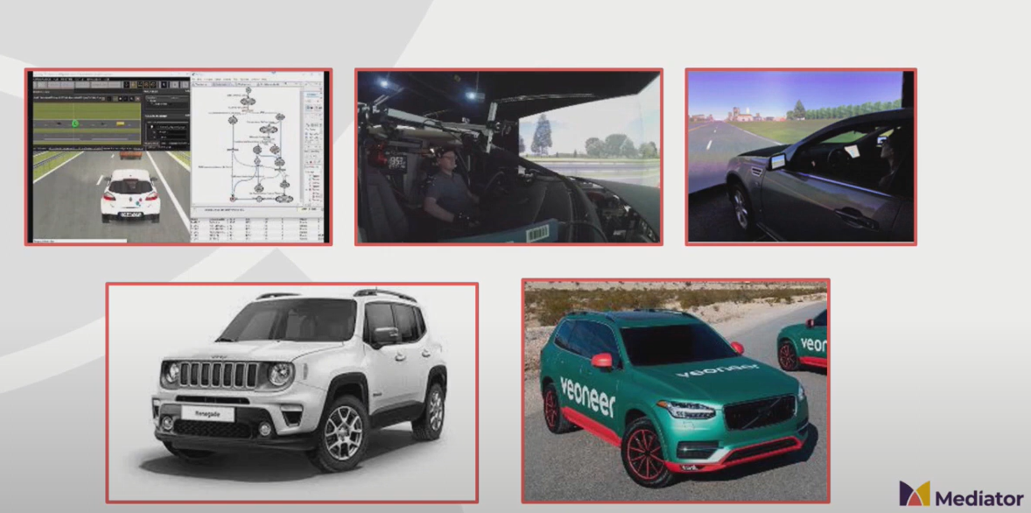
Test Platforms
Notes:
1-Computer simulation evaluates the accuracy of the Mediator decisions whether to allocate vehicle control to the automated system or the driver in different UC.
2-TUC simulator focus is on comfort Ucs with related takeover of control (TOC), simulated automation degradation and related TOC by the human driver, and evaluation of the Mediator system / HMI (e.g. acceptance, trust, usability, comfort, experience of TOC),
3-BGU simulator univ focus on the fatigue algoritms of DS module ( evaluate the effects of preventive and corrective mediation in mitigating the effects of fatigue)
4-Stellantis proto vehicle focus is on the HMI solutions in different driving conditions with UC distraction, and CM in order to select the most appropriate HMI to be used in the second on-road study in Sweden. The 2nd focus is acceptance and trust of the Mediator automation levels through hmi routines
In Sweden focus is to evaluate the functionality, safety effects and user acceptance of the Mediator system under different degraded driver performance conditions, including corrective actions and conditions of degraded automation.
5-Veoneer proto vehicle focus is on the communication of the DS module and the DL module and acquire raw data of the ME modules. It is focus on technical evaluation of the Mediator automation state module system under different driving contexts, including the assessment of well the system is able to predict bad automation performance.
briefly summarize the development steps in the project myself to understand how we got here. hoping to make the best use of the Stellantis prototype vehicle

Slide 13
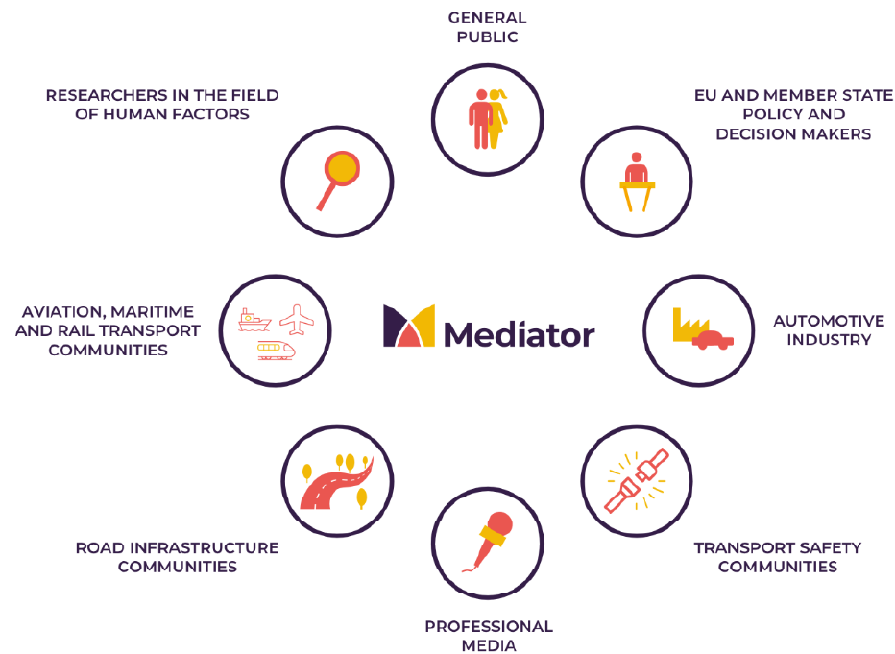
Cross Fertilization
MEDIATOR offers an significant challenge to improve skills, knowledge in addition for developing new guidelines for HMI and future Autonomous Driving applications
The consortium, supported by an international Industrial Advisory Board and a Scientific Advisory Board, will also represent all transport modes, maximizing input from, and transferring results to, aviation, maritime and rail (with mode-specific adaptations).
Richard Schram - EuroNCAP:
«I really like your framework and I will propose the EuroNCAP WG to already implement it»
Satoshi Kitazaki – Director of National Institute of Advantaced Industrial Science and Technology:
«MEDIATOR will be a game changer for designing safer and more comfortable driver-system interactions»
Notes:
The consortium, supported by an international Industrial Advisory Board and a Scientific Advisory Board, will also represent all transport modes, maximising input from, and transferring results to, aviation, maritime and rail (with mode-specific adaptations).
In the definition of exploitation strategy on road transport, relevant inputs are received by aviation, maritime and rail transport for the previous experience on automated and semi-automated driving, on human factors and degraded human performance, automation and decision making, and HMI
design.
The following organisations are, today, members of the IAB (industrial Advisory Board):
• BMW group
• Euro NCAP (European New Car Assessment Programme)
• IAV automotive engineering
• Volvo Car Corporation
• Veoneer
• Valeo

Slide 14
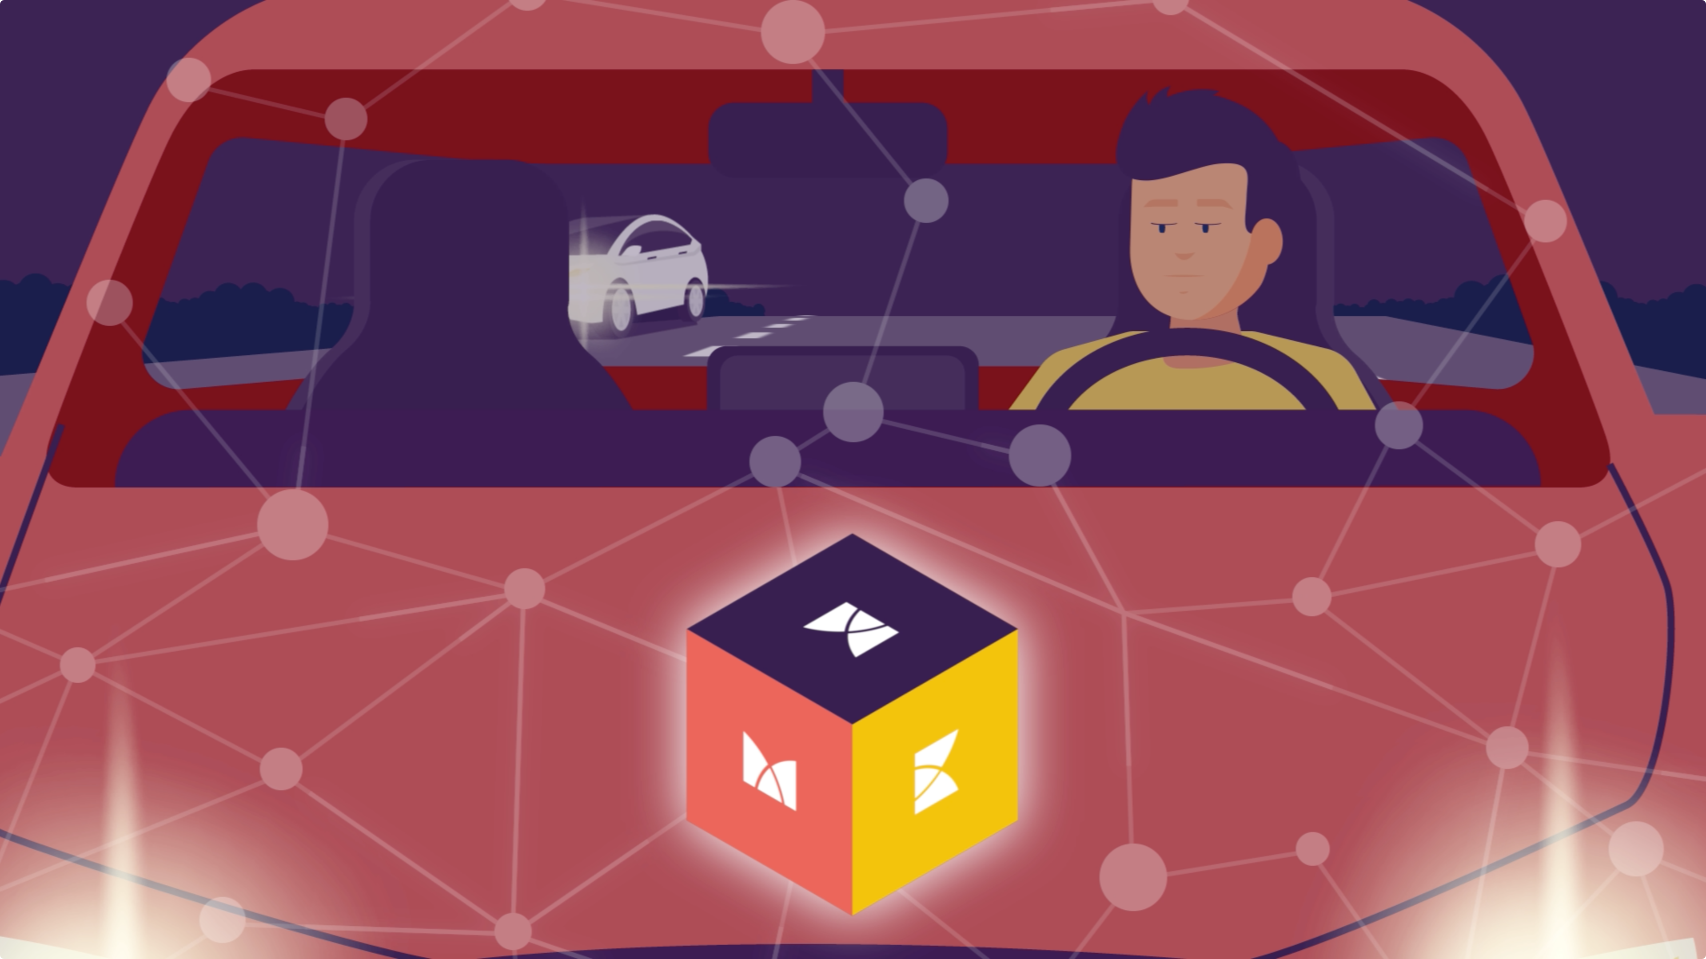
Vision
Optimizes the safety potential of vehicle automation during the transition to full automation (level 5)
Reduces risks, such as those caused by driver fatigue or inattention, or on the automation side imperfect automated driving technology
Mitigates human factors issues generic for all transport modes, with road transport as the main use case
Facilitates market exploitation by actively involving the automotive industry during the development process
Integrates and enhances existing knowledge of human factors and HMI, taking advantage of the of expertise in other transport modes (aviation, rail and maritime).
Develops and adapts available technologies for real-time data collection, storage and analysis and incorporate the latest artificial intelligence techniques, such as deep learning.
Notes:
ME greatest challenges in the transition towards higher levels of automation, is avoiding mode confusion.

Slide 15
Results Exploitation
The MEDIATOR results will influence further research activities in the following areas:
Human factors and the driver-vehicle interaction best practise
New development technologies of Operational Design Domain of the automation on board systems
Methods to measure degraded driver performance
Guidelines for safe, user centred HMI design for intermediate automation levels
Recommendations on legal and regulatory aspects
Notes:
The exploitable results of the ME project are in the form of technologies (hardware and software), new knowledge, and the different kinds of demonstrator vehicles. But these results
1 - problems occurring at intermediate automation levels. The human factor, according to the various driver-related information that is integrated to estimate the Time to Driver Unfitness or Fitness due to fatigue or distraction
2- In the Auto module use the new tech AI , neural and deep learning . In order to implement the Automation assessment on the real time driving context (same parameters for the Automated system)
3- the algorithm implemented to detecti of driver states, the optimisation of decisions, and define the fitness class are used in the ME platforms
4- HMI : holistic approach these challenges include, HMI will guide drivers through different take over processes to avoid unsafe transfers of control.nicating preventive actions to maintain driver fitness.
A better system understanding aims to reduce distrust and erroneous vehicle handling.
The HMI is designed by Delft University, FCA Italy and Altran primarily, with SWOV, Autoliv and Konsberg Maritime, and prototyped by Delft University, Altran and FCA Italy. Constraints based on
individual drivers’ preferences and characteristics, both in terms of driver and automation state, are implemented by Cygnify.
5-

Slide 16
Mediator why sustanaible
Area | Impact - Sustainability
Transport safety communities | ME results are used to improve road safety ensuring a fluent transition between Human and Automated system in the intermediate levels L2-3
Automotive Industry | Results of the real test with naive and professional partecipants help to tuning and performing the future HMI interaction
Research in Human Factors | Data from the ME test from the different platforms help to know the best interaction with different culture and basis
Cross Interaction with Aviation, Rail, Maritime transport | The contribution has been very useful to develop ME modules for the on road prototypes
Professional media – EU member policy | ME system (simulator and real vehicle) ensures the easy and friendly handover between Human and AI for driving is available for different layers of developping
Notes:
Fast, flexible and efficient mobility solutions for testing HMI, sw modules by car makers
MEDIATOR’s work is relevant for the following target groups:
• Transport safety communities • Road infrastructure communities • Automotive industry • Researchers in the field of human factors • Aviation, maritime and rail transport communities
• EU and Member State policy and decision makers • Professional media • Public / end-user

Slide 17

For more informations
www.mediatorproject.eu
Notes:
Have you some q?

